Slide 1
Welcome to Plastics at NUH

Slide 2
Trust set up
Who’s who
The rota
Your responsibilities
IT systems
Quick start guide

Slide 3
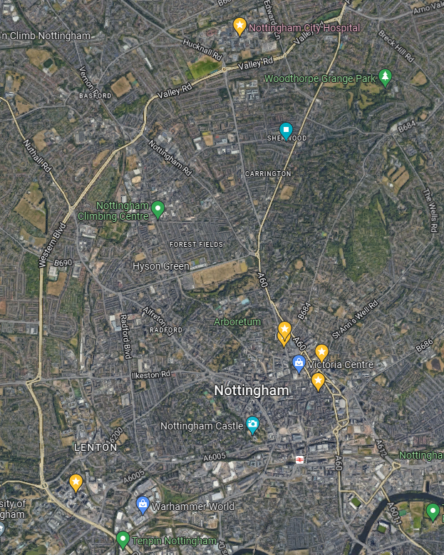
Trust/department set up
NUH
  2 sites: QMC + City
    (drive, medi-link, public transport, taxi)
Plastics is tertiary level referral
  Nottinghamshire, Leicestershire, Derbyshire, lincolnshire

Slide 4
What does plastics cover
Burns – facility / unit / centre - BBA referral guidelines
Hands – split with ortho
Trauma – shared care with ortho
Sarcoma – regional centre
Skin
Breast
Cleft
Specifics to mention; abscesses, facial trauma, pressure sores, lacerations in children

Slide 5
Plastics is a general speciality
Head-to-toe
Cradle-to-grave
Multidisciplinary working
You are the representatives of the department

Slide 6
City Activity
All acute adult burns and plastics admissions “hot week”
Elective operating
Burns dressing clinic
  Burns + acute plastics follow up
Gillies Dressing clinic
  Elective + hands
Hand physio

Slide 7
Queens Activity
Paediatric plastics/burns
Orthoplastic cases (under ortho)
Miscellaneous cases under other specialities
No adult admitting rights at queens

Slide 8
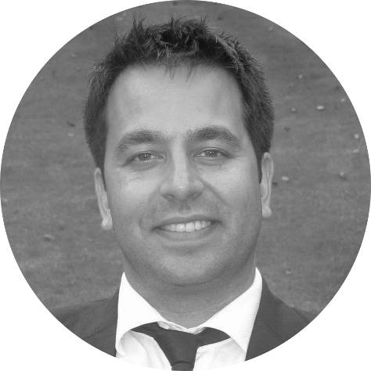
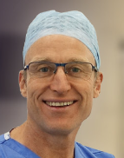
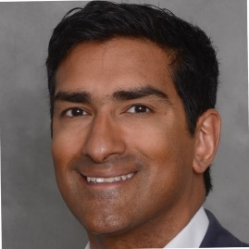
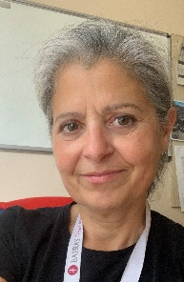
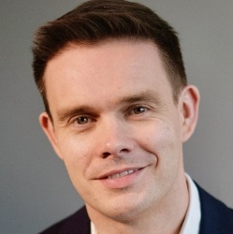
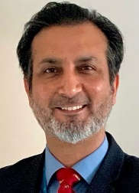

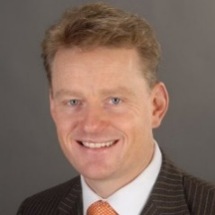
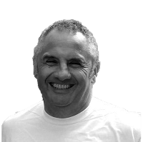

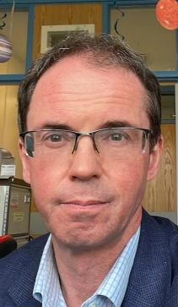
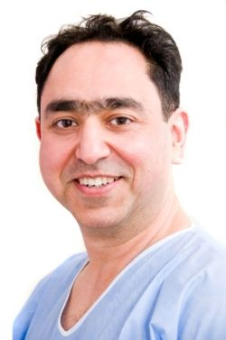

Who’s who
18 consultants
DJC - Mr Dave Clarkson (Head of service – for now) | SH6 - Mr Saiidy Hasham
SJM - Mr Steven McCulley | KA3 - Mr Skaria Alexander
AR7 - Ms Anna Raurell | TR5 - Mr Tuabin Rasheed
KS2 - Ms Kathryn Steele | JP3 - Mr Jonathan Pollock
JCD - Mr John Daly | MST - Mr Sarmad Tamimy
NW - Mr Neil Wickham (ST8) | HM - Miss Hulla Mohammed
HW - Mr Hugh Wright | JSG - Mr Jonathan Syme Grant (Educational lead)
JND - Mr Jason Neil-Dwyer | GO2 - Miss Georgette Oni
MHH - Mr Harris Haseeb | CPO - Mr Ciaran O Boyle

Slide 9
Who’s who
10 Registrars
MA - Mohamed Abdelrazek - (Micro fellow)
LS - Lindsay Shanks - ST8 (Sarcoma)
SB - Shenbana (Shen) Bagirathan - ST7 (Float)
RM - Rossel Morhij - ST7 (Breast)
AF - Alexandra Fielding - ST5 (Adult Burns)
OC - Oliver (Olly) Cotton - TG (QMC Adults)
SKS – Satyndra (Sat) Singh - TG (QMC Paeds)
IP - Ioanna Pentara - TG (Orthoplast)
SM - Stanislau (Stas) Makaranka - TG (Float)
TC - Tom Calderbank - CT2 (Hands)
8 SHOs
1 FY1
Burns nurses, physios, dressings nurses, psychologist, burns anaesthetists

Slide 10
The rota
https://www.nottinghamplasticsrota.com/
Long day – 07:45 – 19:45
Nights – 19:45 – 08:15
Normal day – 07:45 – 17:00
(Mondays and Tuesdays 7:30 start)
Master SHO rota on the trust intranet
  Alex Fielding (registrar) rota coordinator – nottinghamplasticsrota@gmail.com
  ((Alisha Mahmood – junior doctor coordinator))

Slide 11
SHO Long day (oncall)
07:45 start (7.30 Mondays, 7.30 Tuesday)
Hot week ward round + jobs
Clinics – new admissions into burn dressing clinic, reviews in gillies
New referrals via the bleep/phone
Emergency operating with reg/consultant
Looking after burns and plastics patients at city
Points of contact; 8-5pm = hot week reg/cons, 5-8pm; oncall reg/cons
Handover to night SHO at 19:45

Slide 12
SHO Nights
Looking after burns and plastics patient at city
New referrals via the bleep/phone
Checking VTEs
Prepping TTOs
Prepping ward round documentation
Point of contact – oncall reg/cons

Slide 13
SHO Normal days
Clinics – SHOs essentially supernumery
Theatre – check bluespier, see patients before, VTE, TTOs, WBAs
  City main theatres, DSU, QMC, EENT
Queens – trauma meeting at 0800, assist with adults (+/- paeds/paeds clinic)

Slide 14
Registrar
Divided up into ‘firms’ for normal day activity
On calls are from 5pm until 8am following day and are non-resident.
  Weekend on calls are 24hrs from 8 am – again non-resident.
Point of contact OOH is on-call consultant

Slide 15
Teaching
Weekly teaching on Tuesday via teams – 0730.
Rota will be allocated; discuss early with the reg for guidance
Can sign in from home
Most useful for SHOs
Teaching | Nottingham Plastics (nottinghamplasticsrota.com)

Slide 16
Morbidity and mortality
Access to the database
Updated by everyone
4 weekly meetings Monday AM 0800
Allocated slides to prep.

Slide 17
IT systems
Nerve centre
  List management
  E- obs
  Update with plans
  Bed state
  Photographs
  Non-urgent referrals
  [EPMA – coming May]
Careflow
  Requesting and reviewing results
  ED, hand clinic, burns clinic notes
  Bluespier – theatre management
  Notis
  Discharge letters/TTOs
  Some requests
  (legacy system for results)
DHR
  Digitally uploaded notes

Slide 18
Acute plastic surgery pathway
(incl. adult burns)
Referral source:
External Hospital
Internal Referral
QMC ED
External point of care
UCC/GP
Virtual review by hot week team
Urgent review or routine review?
Outcome:
Transfer to city
routine clinic review
Review by QMC reg/team at city
Transfer to city
Urgent QMC team review
routine clinic review
routine clinic review
admit to city ?via ED

Slide 19
Acute plastic surgery pathway
(incl. adult burns)
To admit to burns ward – inform nurse in charge, inform referrer
For burns dressing clinic;
  During the day – can discuss directly with clinic and give appointment time to referrer
  OOH – paperform placed by burns ward reception
  Email burnstriageclinic@nuh.nhs.uk + photos
For gillies dressing clinic;
  During the day – can discuss directly with clinic and give appointment time to referrer
  OOH - paperform placed by burns ward reception d/w GDC in the morning

Slide 20
Adult Hand Injuries Pathway
Referral source:
External Hospital
Internal Referral
QMC ED
External point of care
UCC/GP
Virtual review by hot week team
Admit or clinic?
Outcome:
Transfer to city
routine clinic review
Review by QMC reg
Virtual plan + clinic review
Transfer to city
routine clinic review
routine clinic review
admit to city via ED

Slide 21
Adult Hand Injuries Pathway
Clinic code – PLSHT.
Treatment centre gateway B
Monday AM – post hand weekend only
Thursday AM – every week
Friday AM – every week (same day as trauma list)
ED can book into the clinic
Or Maggie (Margaret.Harvey@nuh.nhs.uk)
OR Nicole (Nicole.glassey@nuh.nhs.uk )
Email hand team after every oncall (the 2 above + hand consultants + spr/sho on lists)
If 16>= + not in full time education can come via adult pathway
Pathway (nottinghamplasticsrota.com)

Slide 22
Paediatric Pathways
External Hospital
Internal Referral
QMC ED
External point of care
UCC/GP
Virtual review by hot week team
Urgent review or routine review?
Outcome:
Transfer to QMC via PED
routine clinic review
Review by QMC paeds reg
Review by reg + admit to D35
routine clinic review
routine clinic review
admit to QMC via PED

Slide 23
Paediatric Pathways
Any paeds patient being admitted MUST come via paeds ED
  Reg review on arrival
  Inform Paeds ED – plus request anything that’s needed
  Inform paeds surgery bed manager – 07812 267134
  Inform referrer to attend Paeds ED
  +/- book for theatre
For clinic review
  During the day – ring paeds clinic to get appointment time + inform referrer
  OOH – ring D35 and ask to complete “blue paeds plastics clinic form”
  Email childrensburnsandplastics@nuh.nhs.uk + photos

